Slide 1
Self Driving Car Game
MVP
(Minimum Viable Product)
Presentation

Slide 2
Group Members
Bhaviya Chopra (TL)
Gagandeep Singh
Favour Eseagwu
Ashwin Philip
Mohammedfaiq Shaikh

Slide 3
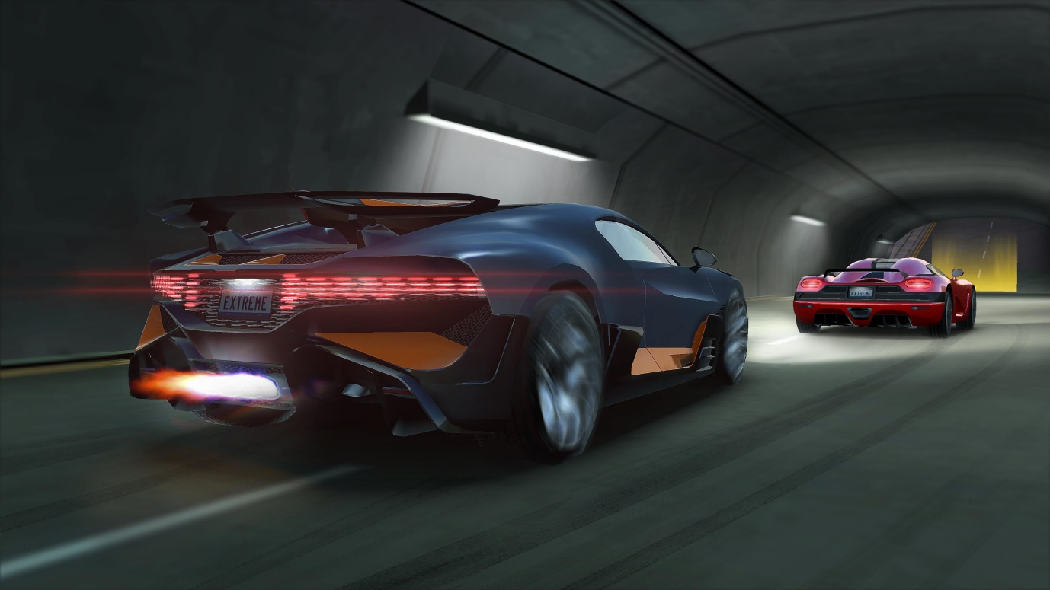
Work Done
Data Collection
Training the data
Prediction

Slide 4
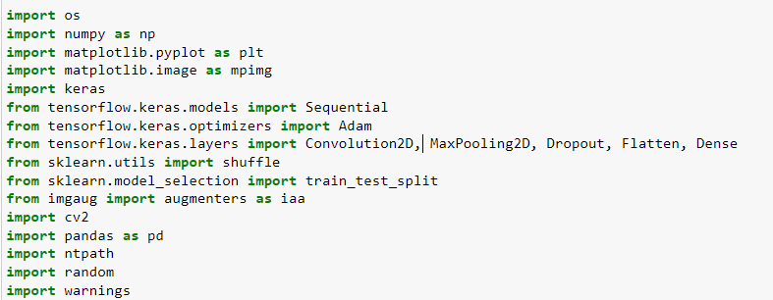
Importing Libraries

Slide 5
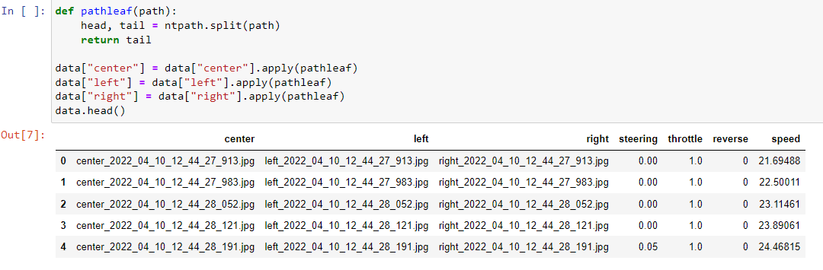
Displaying the first five values for the CSV
Using ntpath function to get the network path assigned

Slide 6
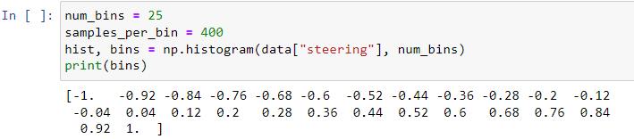
We have bin the number of values where the number will be equal to 25 (odd number aimed to get center distribution). We will see the histogram using the np.histogram option on data frame ‘steering’, we divide it to the number of bins. We keep samples at 400 and then we draw a line. We see the data is centered along the middle that is 0.

Slide 7
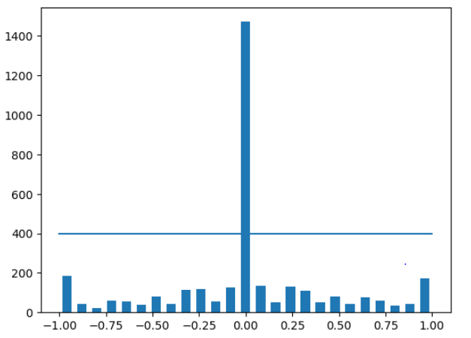

Slide 8
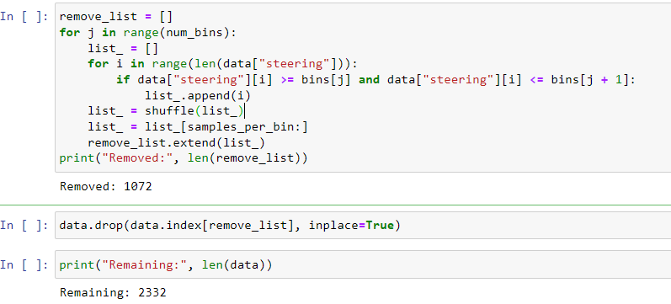
We have specified a variable rove_list and specify samples we want to remove using looping construct through every single bin we will iterate through all the steering data. We will shuffle the data and remove some from it as it is now uniformly structured after shuffling.

Slide 9
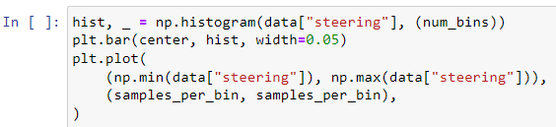
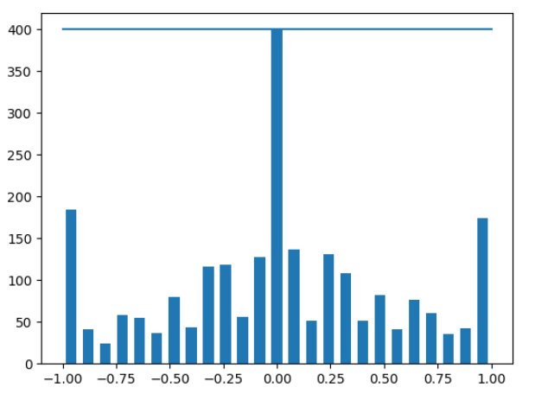

Slide 10
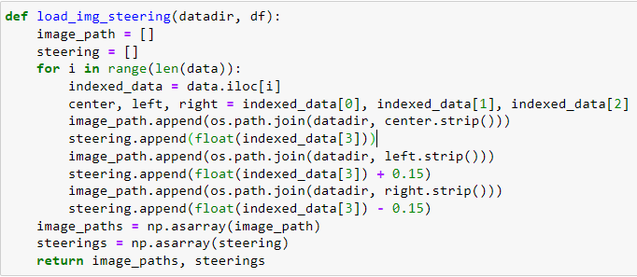
Now loading the image into array to manipulate them accordingly. We have defined a function named locd_img_steering. We have image path as empty list and steering as empty list and then loop through. We use iloc selector as data frame based on the specific index we will use cut data for now.

Slide 11
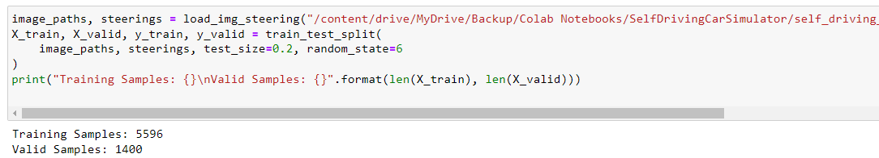
We will be splitting the image path as well as storing arrays accordingly.

Slide 12
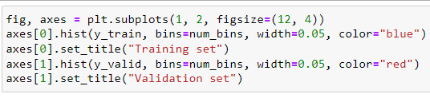
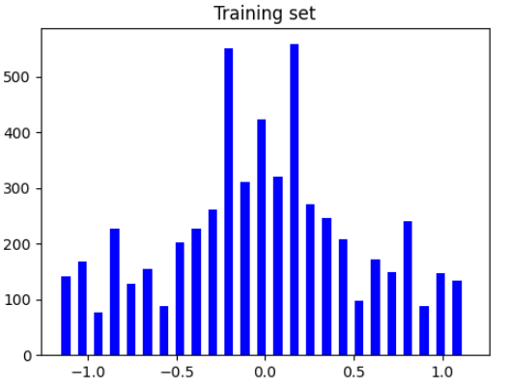
Histogram

Slide 13
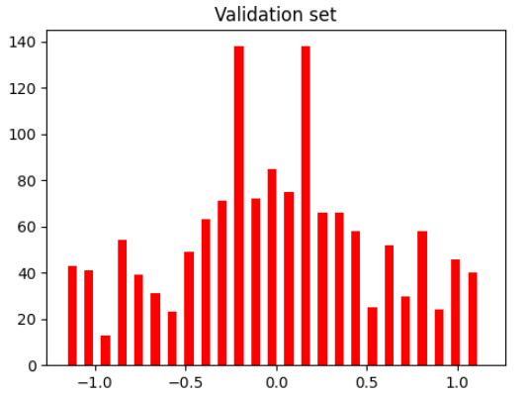

Slide 14
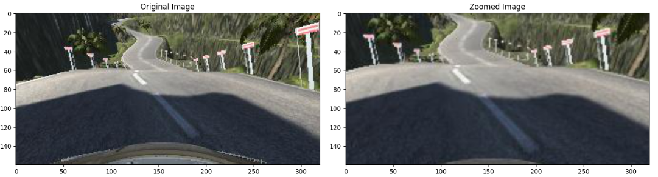
In the next steps, we normalize the data and in the nvdia model, we will have to keep it in a UAV pattern as well as slice unnecessary information. We preprocess the image too.
The images in the dataset have relevant features in the lower part where the road is visible. The external environment above a certain image portion will never be used to determine the output and thus can be cropped. Approximately, 30% of the top portion of the image is cut and passed in the training set.

Slide 15
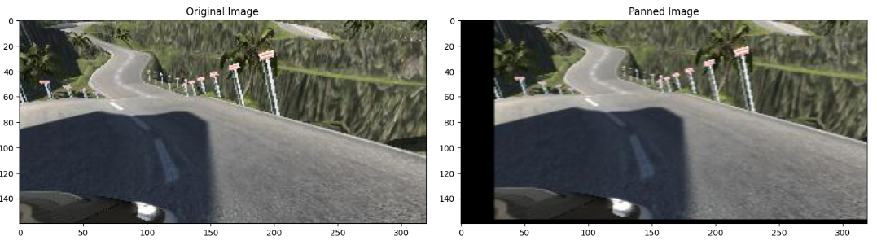
Shift(horizontal/vertical).The image is shifted by a small amount, it is vertical shift and horizontal shift as below.

Slide 16
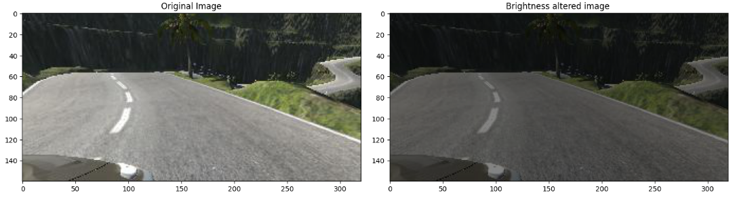
Brightness. To generalize to the weather conditions with bright sunny day or cloudy, lowlight conditions, the brightness augmentation can prove to be very useful. The code snippet and increase of brightness can be seen below. Similarly, we have randomly also lowered down the level of brightness for other conditions.

Slide 17
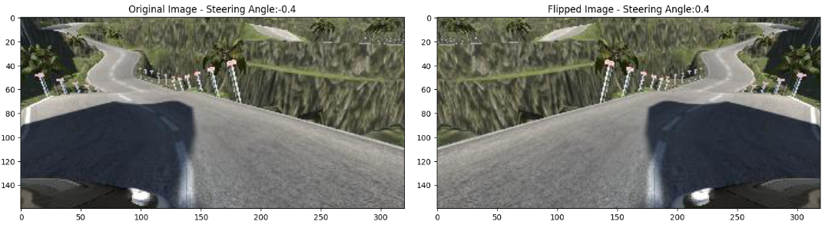
Flip(horizontal).The image is flipped horizontally (i.e. a mirror image of the original image is passed to the dataset). The motive behind this is that the model gets trained for similar kinds of turns on opposite sides too. This is important because Track 1 includes only left turns. The snippet of code and transformation of an image after flipping it can be seen in below.

Slide 18
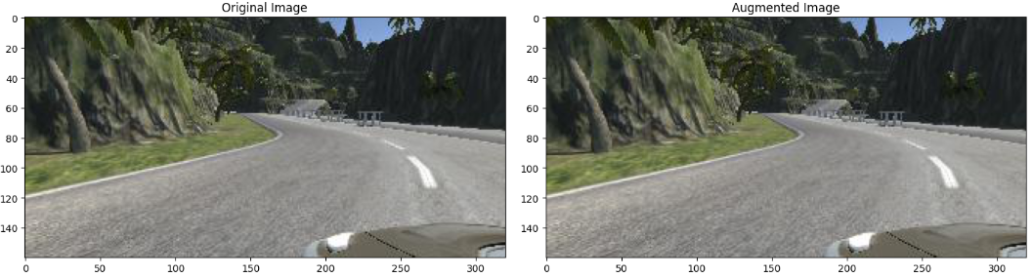
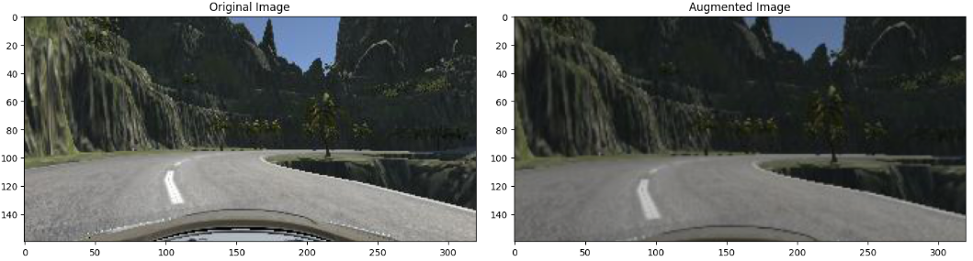
Having a look at what we have done so far.

Slide 19
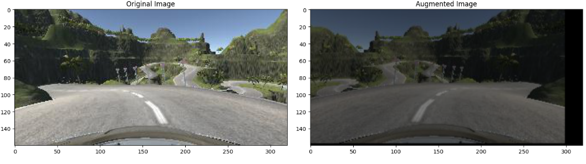
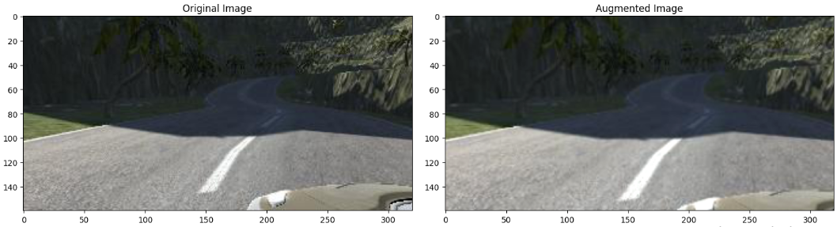

Slide 20
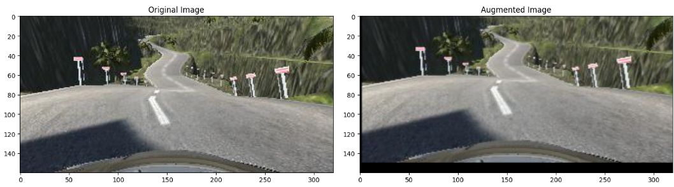
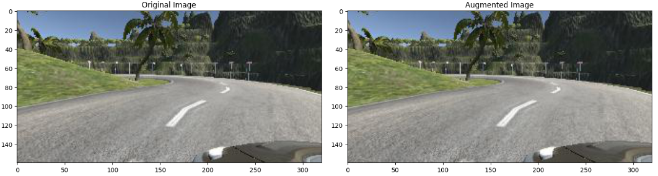

Slide 21
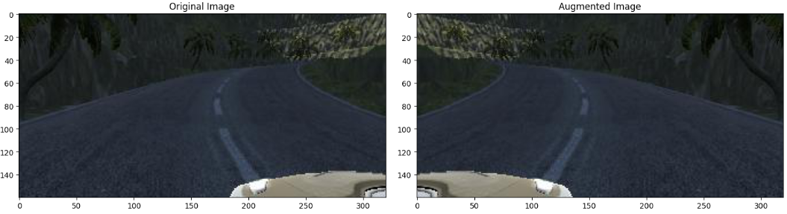
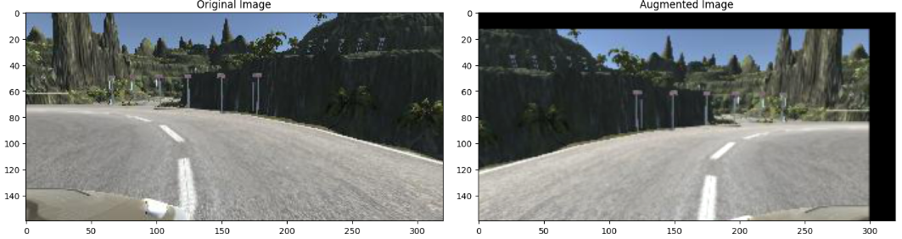

Slide 22
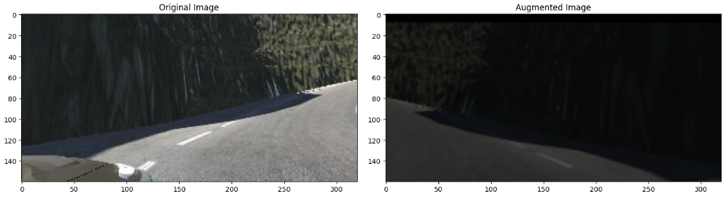
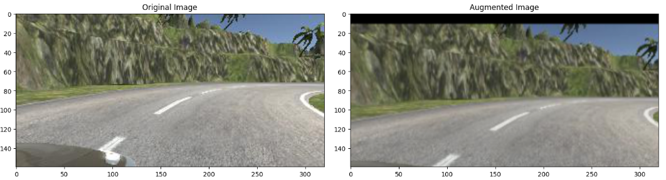

Slide 23
Thank You

